Slide 1

ONLINE SHOPPERS INTENTION ANALYSIS
Student Name: Natalia de Oliveira Rodrigues
Student ID: 2023112

Slide 2

BUSINESS UNDERSTANDING
The aim of the project is use Machine Learning Model to predict the visitors’ intention visiting a online shop given them clickstream and session data.

Slide 3





BUSINESS DESCRIPTION
Research Question
General Goal
Successful Outcome
Can we predict if a user will make a purchase on an e-commerce website given their clickstream and session data?
Apply Machine Learning Model to predict online shop visitors’ intentions.
Apply Cross-Validation and Tunning Methodologies to get solid results.
The Random Forest Classifier Model presented the best results when compared with the other two models applied in this paper. The average accuracy score is 0.93 across 10-folds.
Min ACC: 0.92
Max ACC: 0.94.

Slide 4

TECHNOLOGIES & METHODOLOGIES
Three (3) Machine Learning Models trained. Random Forest, Decision Tree, and SVC.
Cross-Validation
Hyperparameters Tuning GridSearchCV
Jupyter Notebook
More than 10 Python Libraries were used. Including: Pandas, Numpy, Seaborn, Matplotlib, and Sklearn.
CRISP-DM Methodology
GitHub Repository

Slide 5


ACCOMPLISHMENTS
The Data
Exploratory Data Analysis
Data Preparation
Modelling
Cross-Validation
SHAP
.

Slide 6
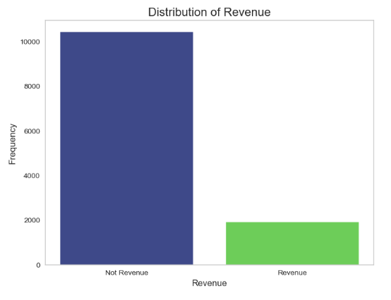
DATA
Dataset
Attributes
12,330 Rows
18 Attributes
Target Variable
14 Numerical
3 Categorical
“Revenue”
Binary Classification Problem

Slide 7
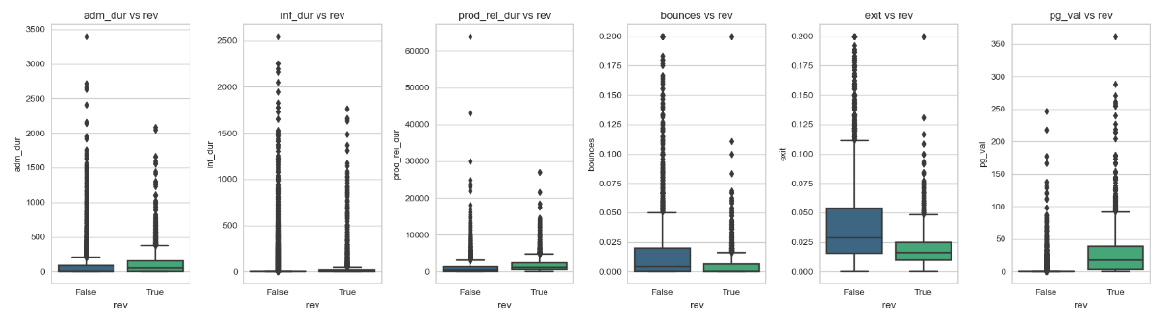
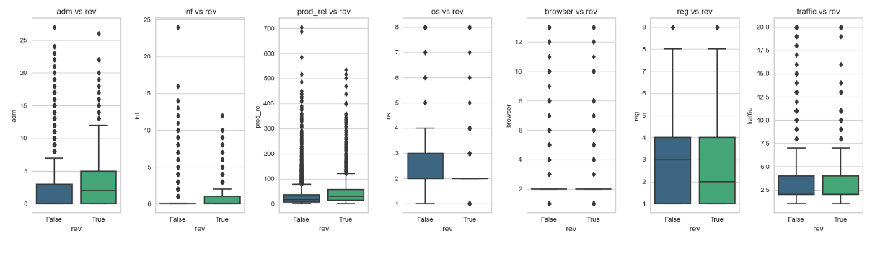
DISTRIBUTION & OUTLIERS

Slide 8
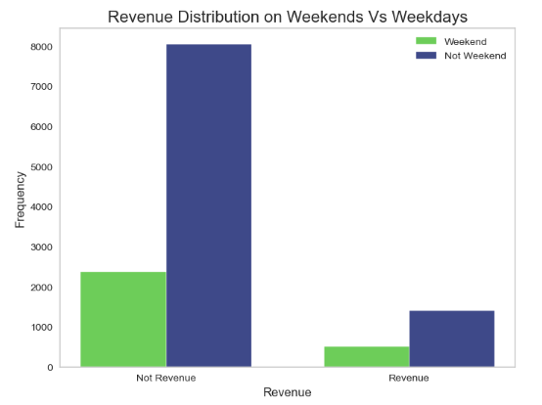
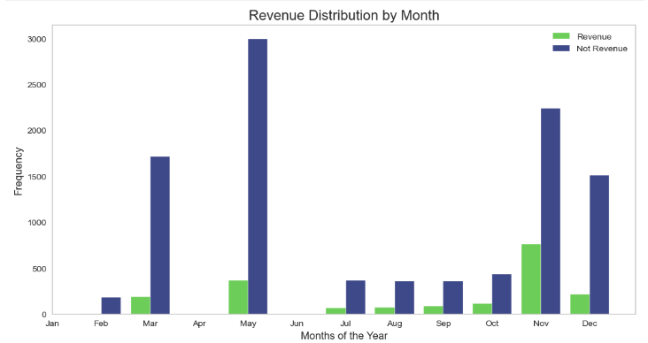
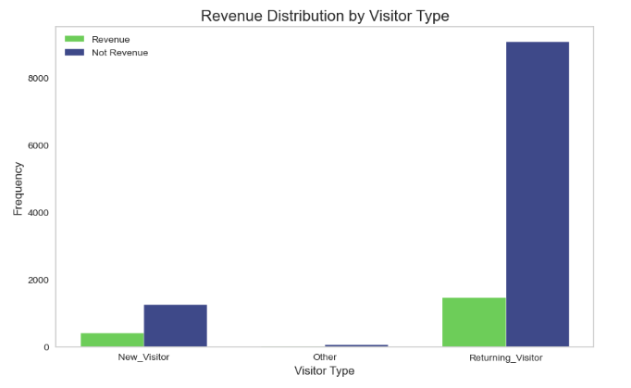
EXPLORATORY DATA ANALYSIS

Slide 9
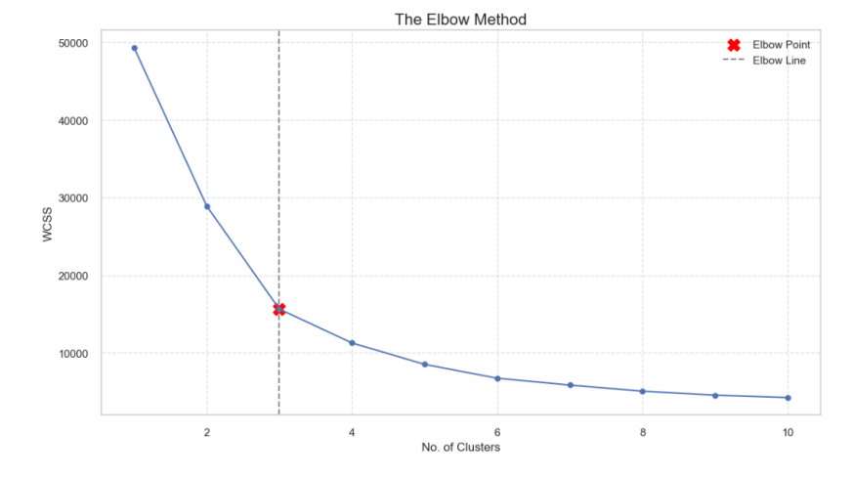
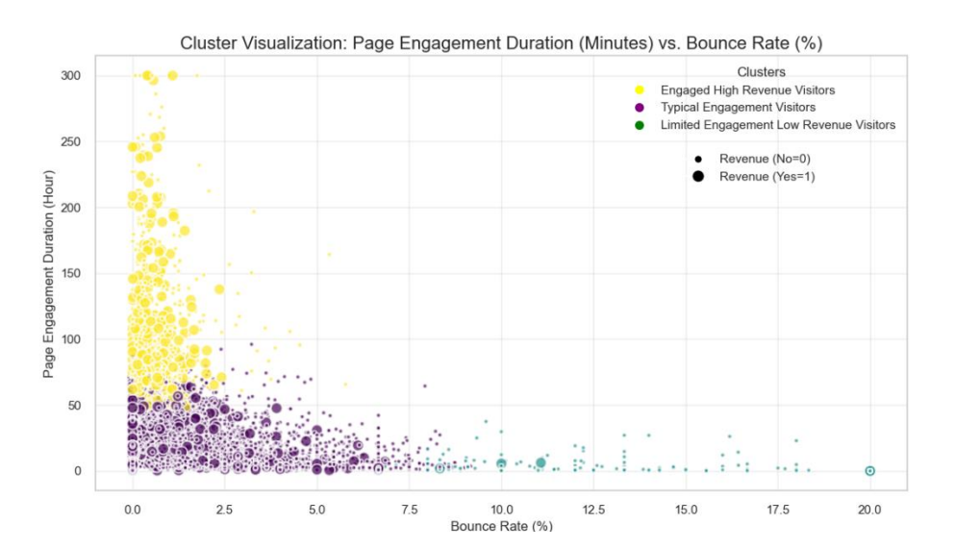
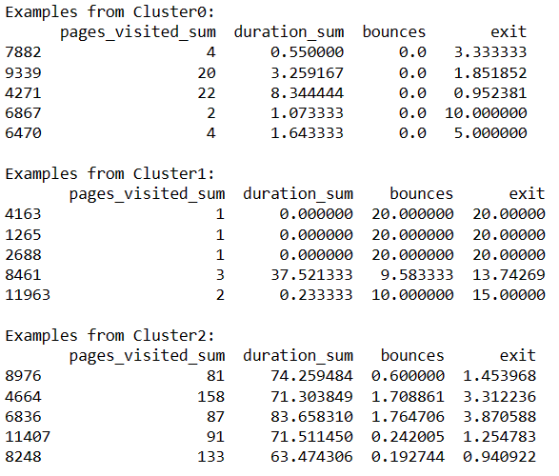
CLUSTER ANALYSIS

Slide 10
CHALLENGES & DATA PREPARATION
+30 values = Continuous
ANOVA Test
Chi-Squared Test
3 Attributes Dropped
Correlation Analysis: Chi- squared and ANOVA test
Handle Outliers with Robust Scaling
Split Training set (80%) and Testing set (20%)
Use SMOTE to balance the data.
Balancing Data
SMOTE
Normalize Robust Scaling
Split Train 80% and Test 20%
Data For Machine Learning

Slide 11
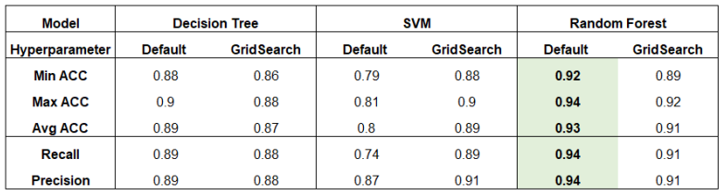
MODELLING PROCESS
Decision Tree Classifier
Random Forest Classifier
SVC
+50 Tests
Grid SearchCV and Cross Validation
GridSearch best values
Default hyperparameters
Stratified Cross Validation 5-Folds
Stratified Cross Validation 10-Folds
Feature Engineering
All attributes
Only Relevant attributes
05
01
04
PCA
With PCA - 3 Columns
Without PCA
Normalize Data
Without Scale
Standard Scale
Min & Max Scale
Robust Scale
02
03
Balance Data
Without Balance
NearMiss
SMOTE

Slide 12
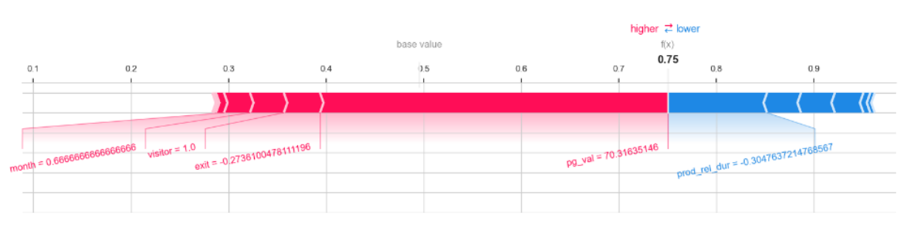
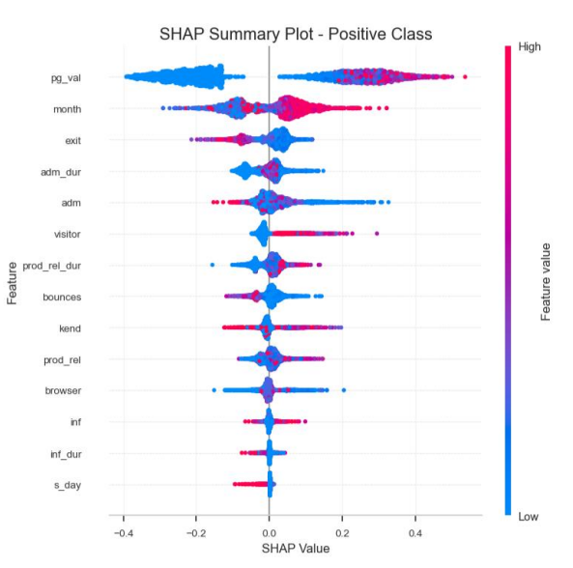
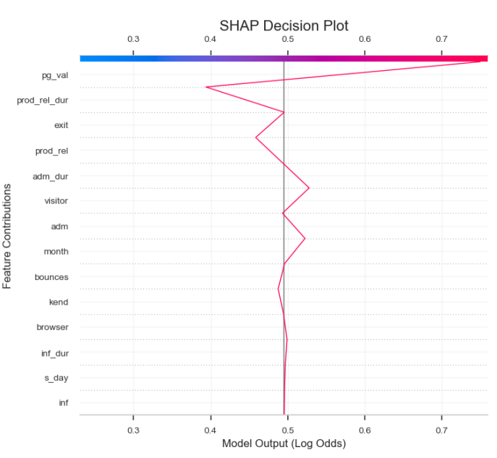
MODEL’S DECISION
SHAP Decision Test: Index 8

Slide 13
Thank You!
CONCLUSION
We conclude that, effectively, we can predict the shopper’s intention on an e-commerce website given their clickstream and session data.
Utilizing Random Forest Classification Model, with accuracy average of 93% across 10-Folds.

